Slide 1
3D Seismic Interpretation of
Mars-Ursa, Mississippi Canyon, GOM
Group 3:
Christopher Tietz
Mark Jeska
Nadima Dwihusna
Notes:
15 min presentation and 5 min discussion
Bring presentation on USB stick

Slide 2
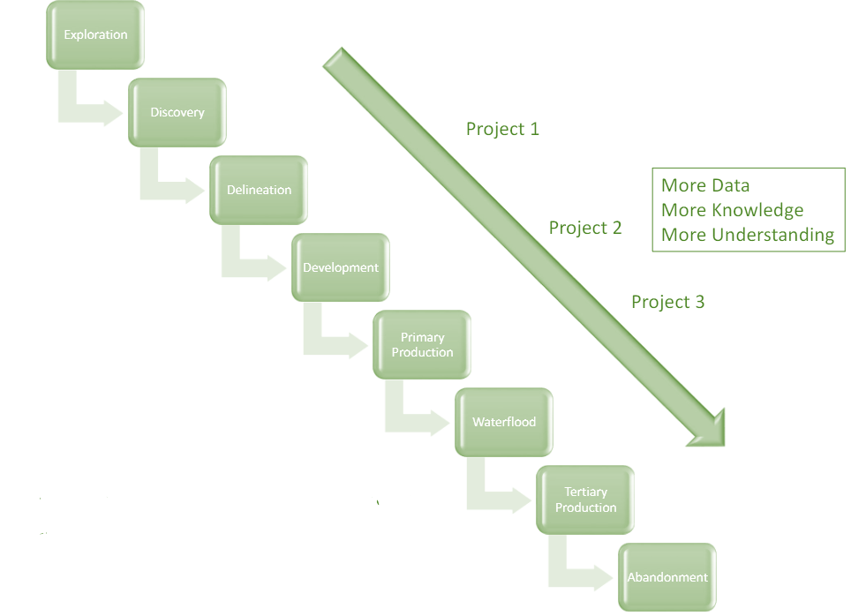
Notes:
We want to focus on the red box
How we interpret seismic data

Slide 3
Exploration Workflow
Geological
Framework
Data
Analysis
Prospect
Elements
Prospect Assessment
Structural Interpretation
- Faults and folds
- Uplifts
- Structural trends/features
Stratigraphic Interpretation
- Unconformities
- Packages
- Facies, lithologies, ages
Present Day Conditions
Analyze Key Packages
- Potential Reservoirs
- Source Rocks
Identify Prospects
- Source
- Migration
- Reservoir
- Trap
Propose a Drill Site to Management
Chance of Success
- Trap size
- Hydrocarbon Content
- Compartments
- Recovery factor
Notes:
Develop geologic framework
Major faults, unconformities and stratigraphic packages (depositional sequences)
Structural interpretations
Faults folds
Uplifts
Structural trends and features
Stratigraphic interpretation
Unconformities
Packages
Facies, lithologies, ages
Basin reconstruction - how things evolved
Data analysis
Analyze all the key packages -- where are potential reservoirs, source rocks, etc
Present day conditions - how things are now
Prospect elements (Source, Migration, Reservoir, Trap)
Identify prospects -- where all the HC system elements look favorable
Where we are willing to propose a drill site to management
Prospect assessments
What type of volume of HC do we expect?
What is the chance of success or risk?

Slide 4
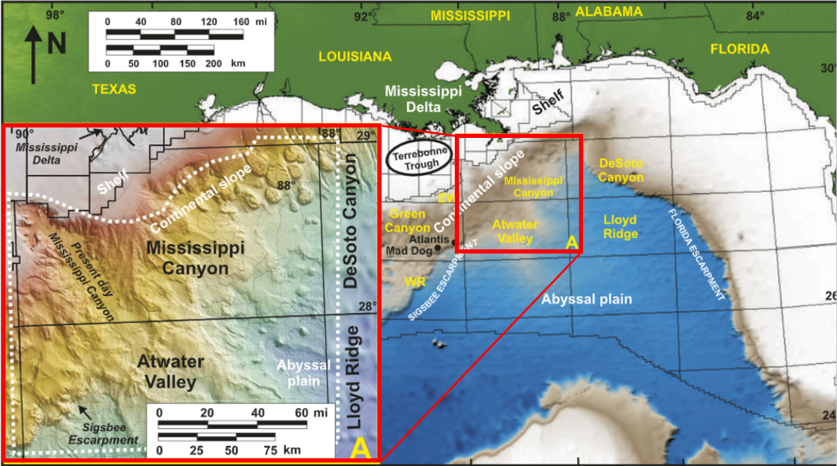
Project Location
Geological
Framework
Data
Analysis
Prospect
Elements
Prospect Assessment

Slide 5
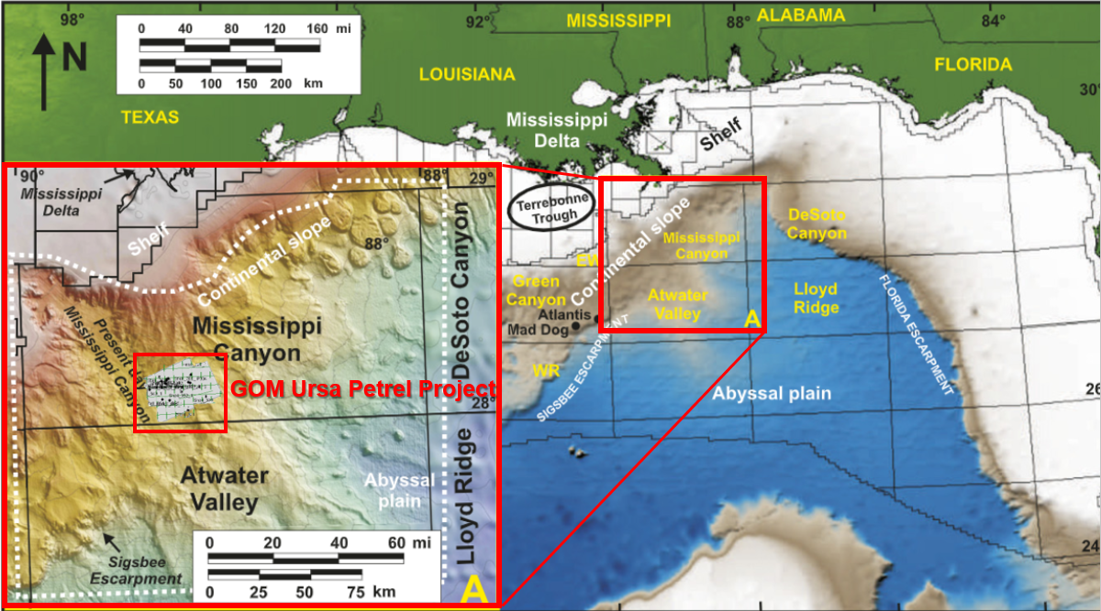
Project Location
Geological
Framework
Data
Analysis
Prospect
Elements
Prospect Assessment

Slide 6
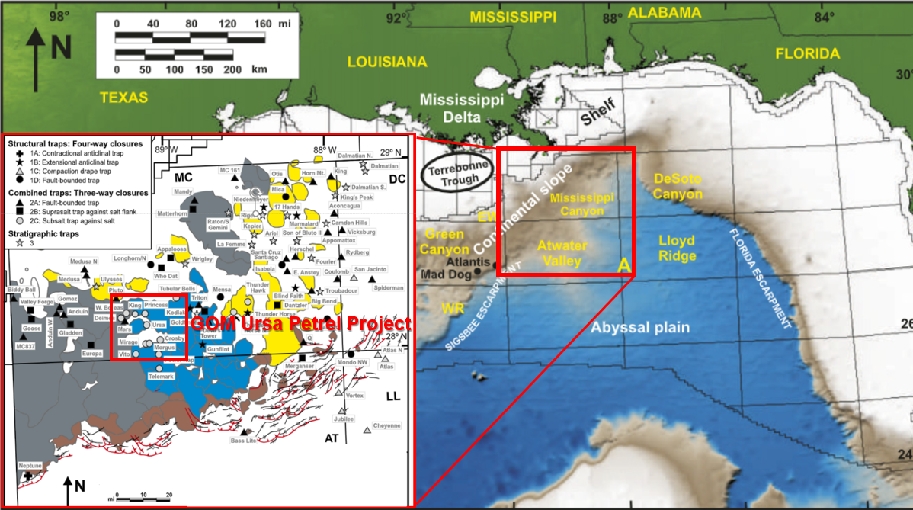
Project Location
Geological
Framework
Data
Analysis
Prospect
Elements
Prospect Assessment

Slide 7
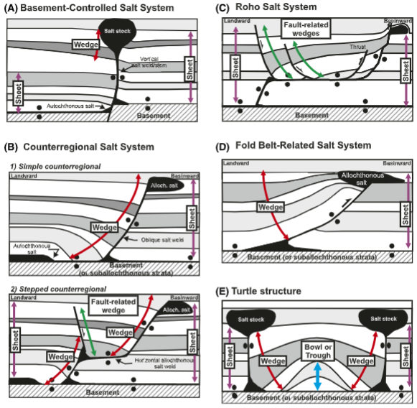
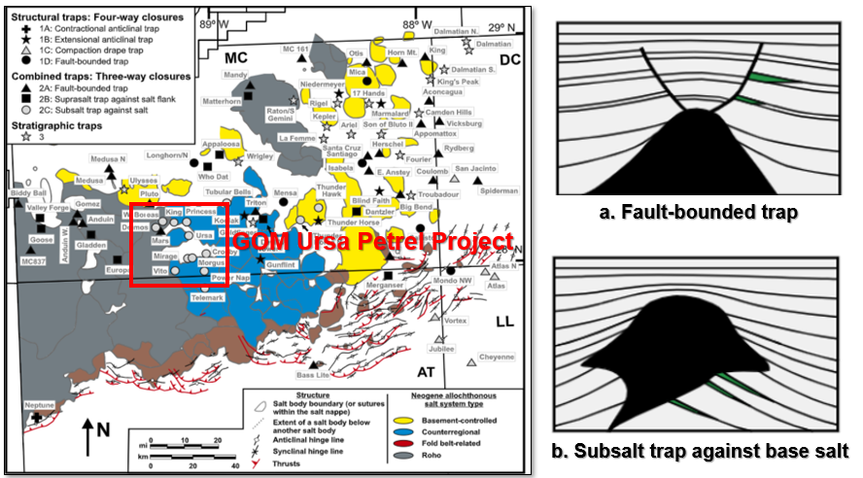
Trap Types
Geological
Framework
Data
Analysis
Prospect
Elements
Prospect Assessment

Slide 8
Trap Types
Geological
Framework
Data
Analysis
Prospect
Elements
Prospect Assessment

Slide 9
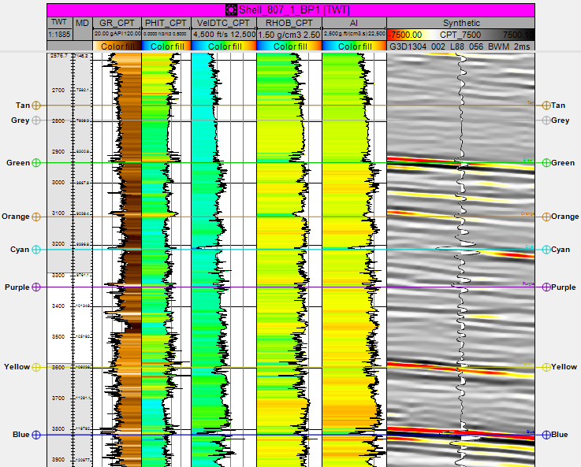
2D Seismic and Well Log
Geological
Framework
Data
Analysis
Prospect
Elements
Prospect Assessment

Slide 10
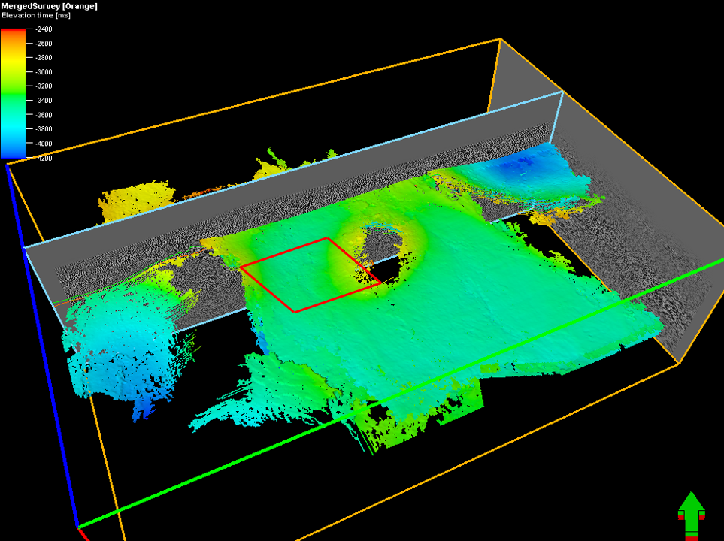
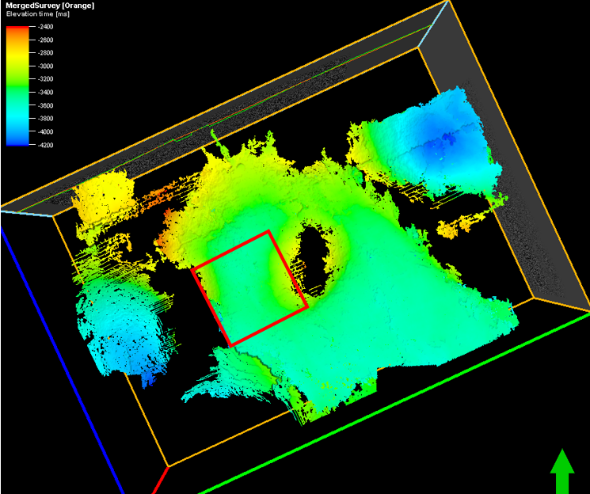
3D Seismic Map
Geological
Framework
Data
Analysis
Prospect
Elements
Prospect Assessment

Slide 11
Exploration Workflow
Geological
Framework
Data
Analysis
Prospect
Elements
Prospect Assessment
Structural Interpretation
- Faults and folds
- Uplifts
- Structural trends/features
Stratigraphic Interpretation
- Unconformities
- Packages
- Facies, lithologies, ages
Present Day Conditions
Analyze Key Packages
- Potential Reservoirs
- Source Rocks
Identify Prospects
- Source
- Migration
- Reservoir
- Trap
Propose a Drill Site to Management
Chance of Success
- Trap size
- Hydrocarbon Content
- Compartments
- Recovery factor
Notes:
Develop geologic framework
Major faults, unconformities and stratigraphic packages (depositional sequences)
Structural interpretations
Faults folds
Uplifts
Structural trends and features
Stratigraphic interpretation
Unconformities
Packages
Facies, lithologies, ages
Basin reconstruction - how things evolved
Data analysis
Analyze all the key packages -- where are potential reservoirs, source rocks, etc
Present day conditions - how things are now
Prospect elements (Source, Migration, Reservoir, Trap)
Identify prospects -- where all the HC system elements look favorable
Where we are willing to propose a drill site to management
Prospect assessments
What type of volume of HC do we expect?
What is the chance of success or risk?

Slide 12
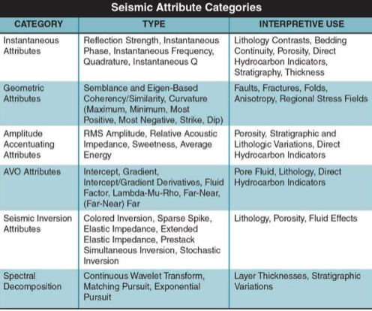
Seismic Attribute Categories
Geological
Framework
Data
Analysis
Prospect
Elements
Prospect Assessment

Slide 13
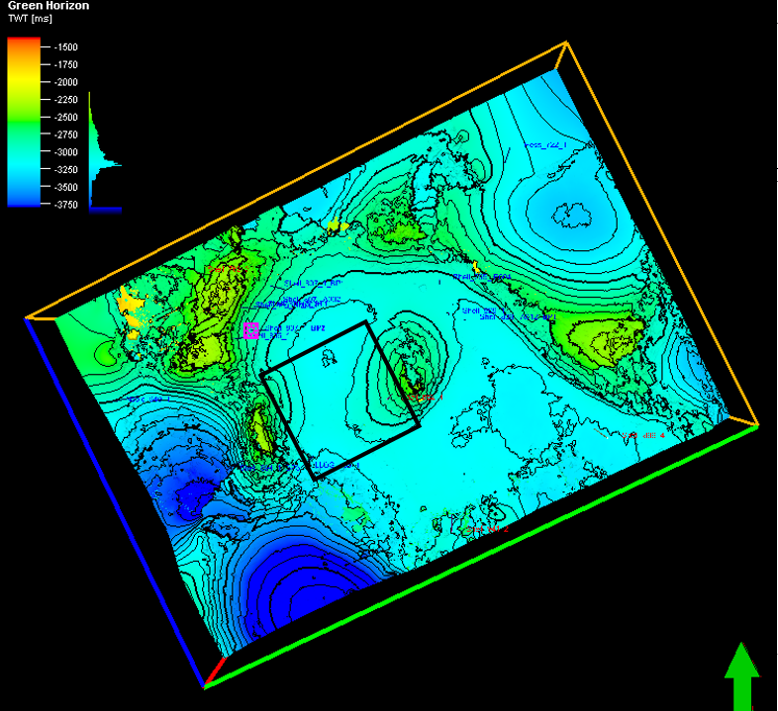
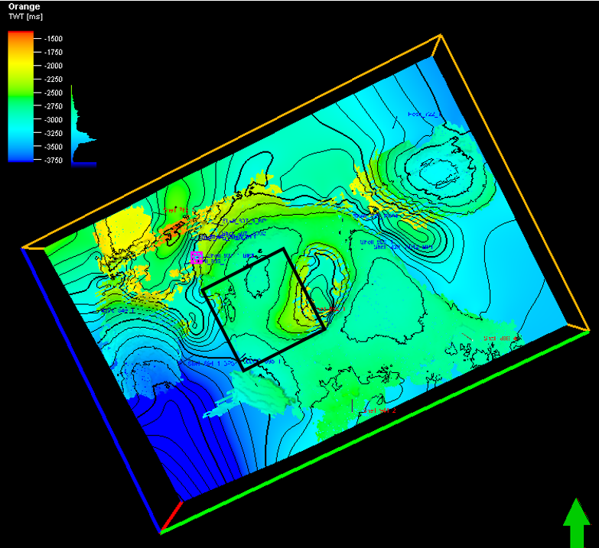
Time Structure Maps
Green Horizon
Orange Horizon
Geological
Framework
Data
Analysis
Prospect
Elements
Prospect Assessment

Slide 14
Seismic Attribute Categories
Geological
Framework
Data
Analysis
Prospect
Elements
Prospect Assessment

Slide 15
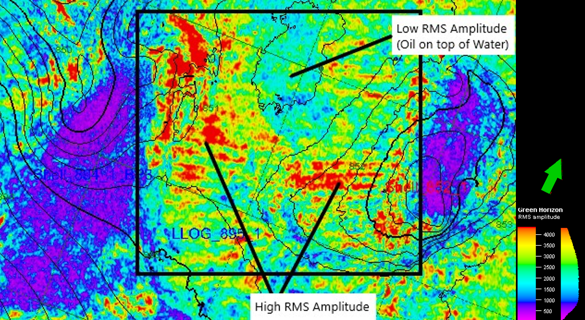
Amplitude Map Over Time-Structure Map
Geological
Framework
Data
Analysis
Prospect
Elements
Prospect Assessment
Notes:
Figure 8: Amplitude map draped over time-structure map of Green Horizon showing same boxed the potential areal extent of the reservoir

Slide 16
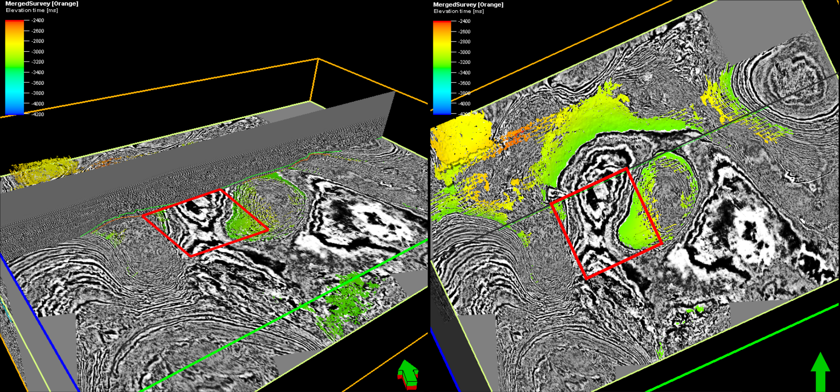
Time-Slices and Stratal Slices
Geological
Framework
Data
Analysis
Prospect
Elements
Prospect Assessment

Slide 17
Exploration Workflow
Geological
Framework
Data
Analysis
Prospect
Elements
Prospect Assessment
Structural Interpretation
- Faults and folds
- Uplifts
- Structural trends/features
Stratigraphic Interpretation
- Unconformities
- Packages
- Facies, lithologies, ages
Present Day Conditions
Analyze Key Packages
- Potential Reservoirs
- Source Rocks
Identify Prospects
- Source
- Migration
- Reservoir
- Trap
Propose a Drill Site to Management
Chance of Success
- Trap size
- Hydrocarbon Content
- Compartments
- Recovery factor
Notes:
Develop geologic framework
Major faults, unconformities and stratigraphic packages (depositional sequences)
Structural interpretations
Faults folds
Uplifts
Structural trends and features
Stratigraphic interpretation
Unconformities
Packages
Facies, lithologies, ages
Basin reconstruction - how things evolved
Data analysis
Analyze all the key packages -- where are potential reservoirs, source rocks, etc
Present day conditions - how things are now
Prospect elements (Source, Migration, Reservoir, Trap)
Identify prospects -- where all the HC system elements look favorable
Where we are willing to propose a drill site to management
Prospect assessments
What type of volume of HC do we expect?
What is the chance of success or risk?

Slide 18
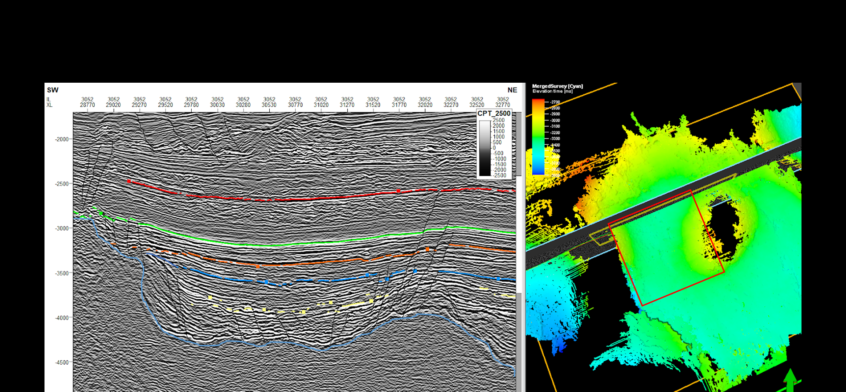
Inline 3052
Geological
Framework
Data
Analysis
Prospect
Elements
Prospect Assessment

Slide 19
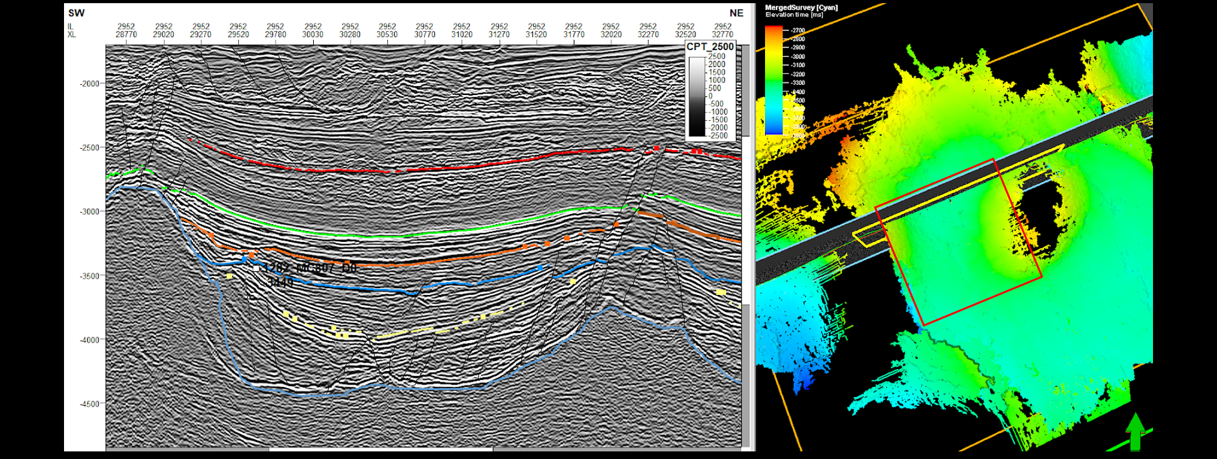
Inline 2952
Geological
Framework
Data
Analysis
Prospect
Elements
Prospect Assessment

Slide 20
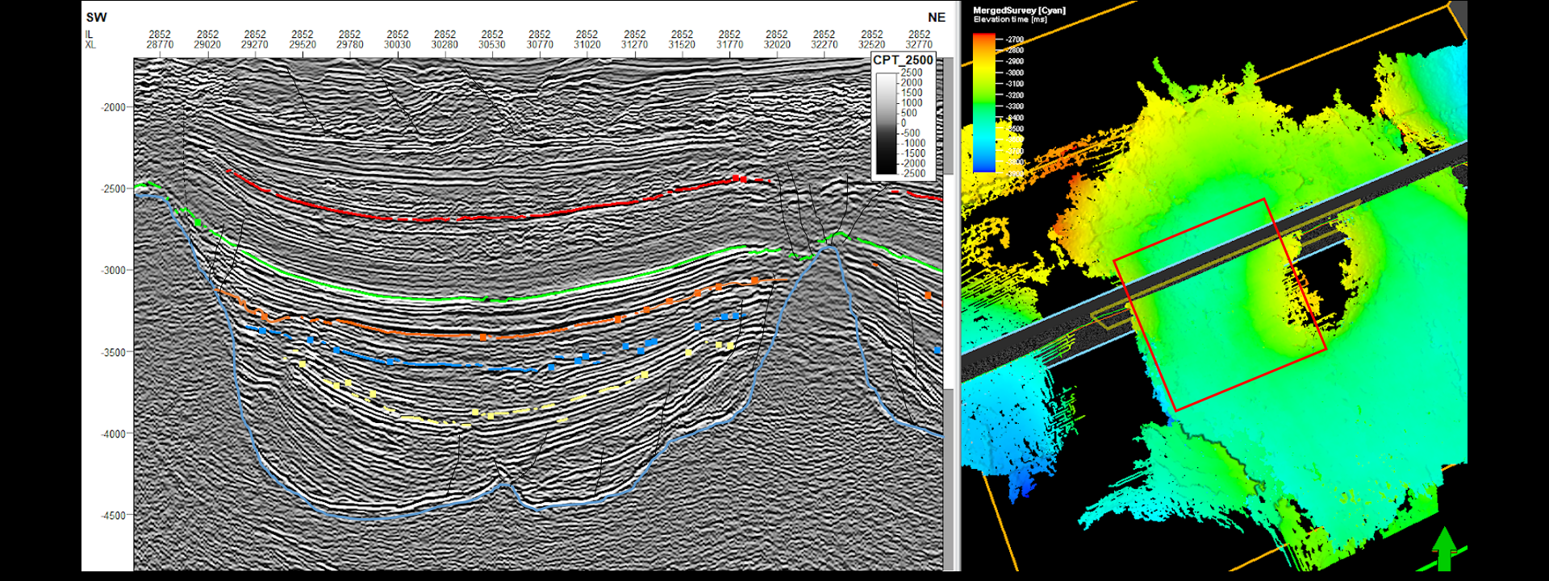
Inline 2852
Geological
Framework
Data
Analysis
Prospect
Elements
Prospect Assessment

Slide 21
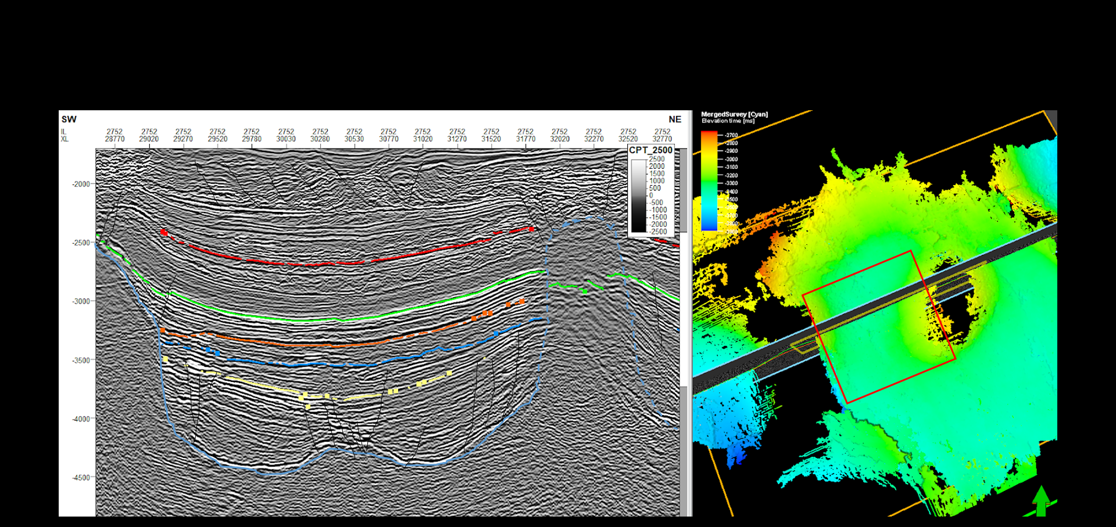
Inline 2752
Geological
Framework
Data
Analysis
Prospect
Elements
Prospect Assessment

Slide 22
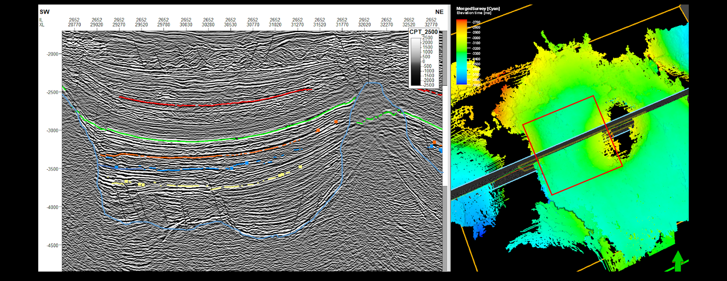
Inline 2652
Geological
Framework
Data
Analysis
Prospect
Elements
Prospect Assessment

Slide 23
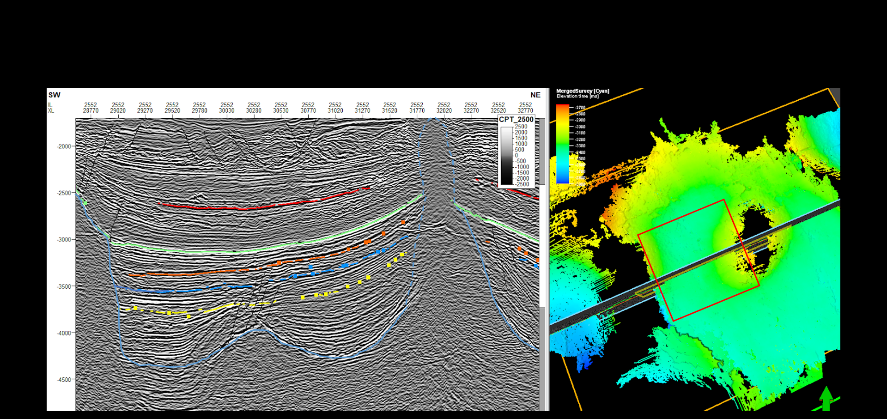
Inline 2552
Geological
Framework
Data
Analysis
Prospect
Elements
Prospect Assessment

Slide 24

Inline 2452
Geological
Framework
Data
Analysis
Prospect
Elements
Prospect Assessment

Slide 25
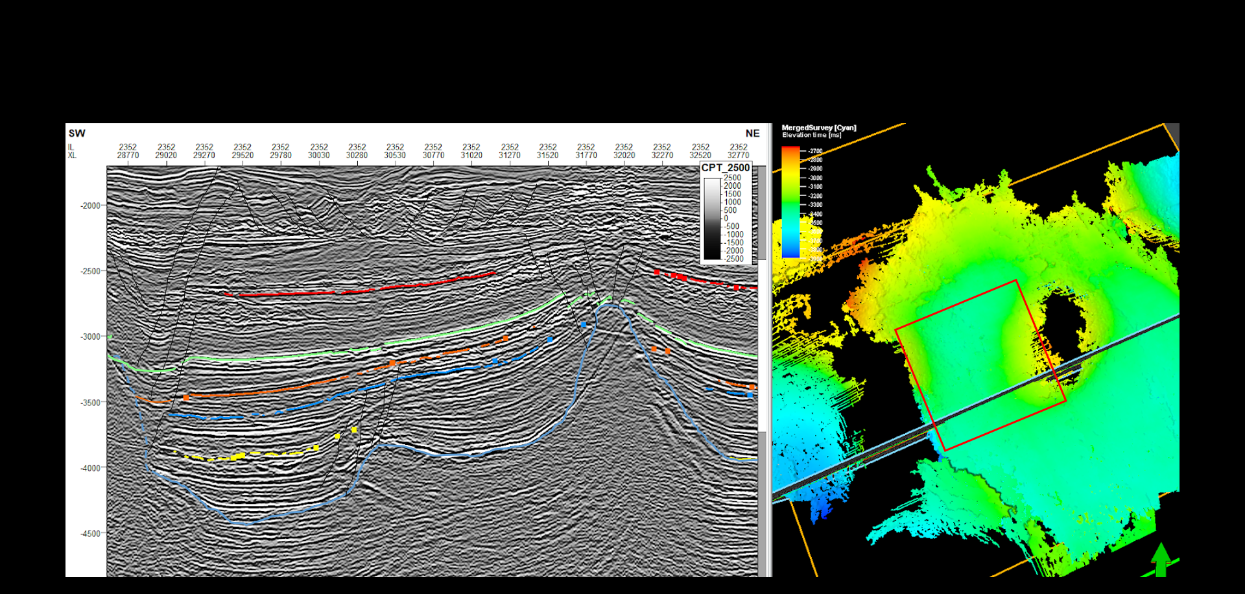
Inline 2352
Geological
Framework
Data
Analysis
Prospect
Elements
Prospect Assessment

Slide 26

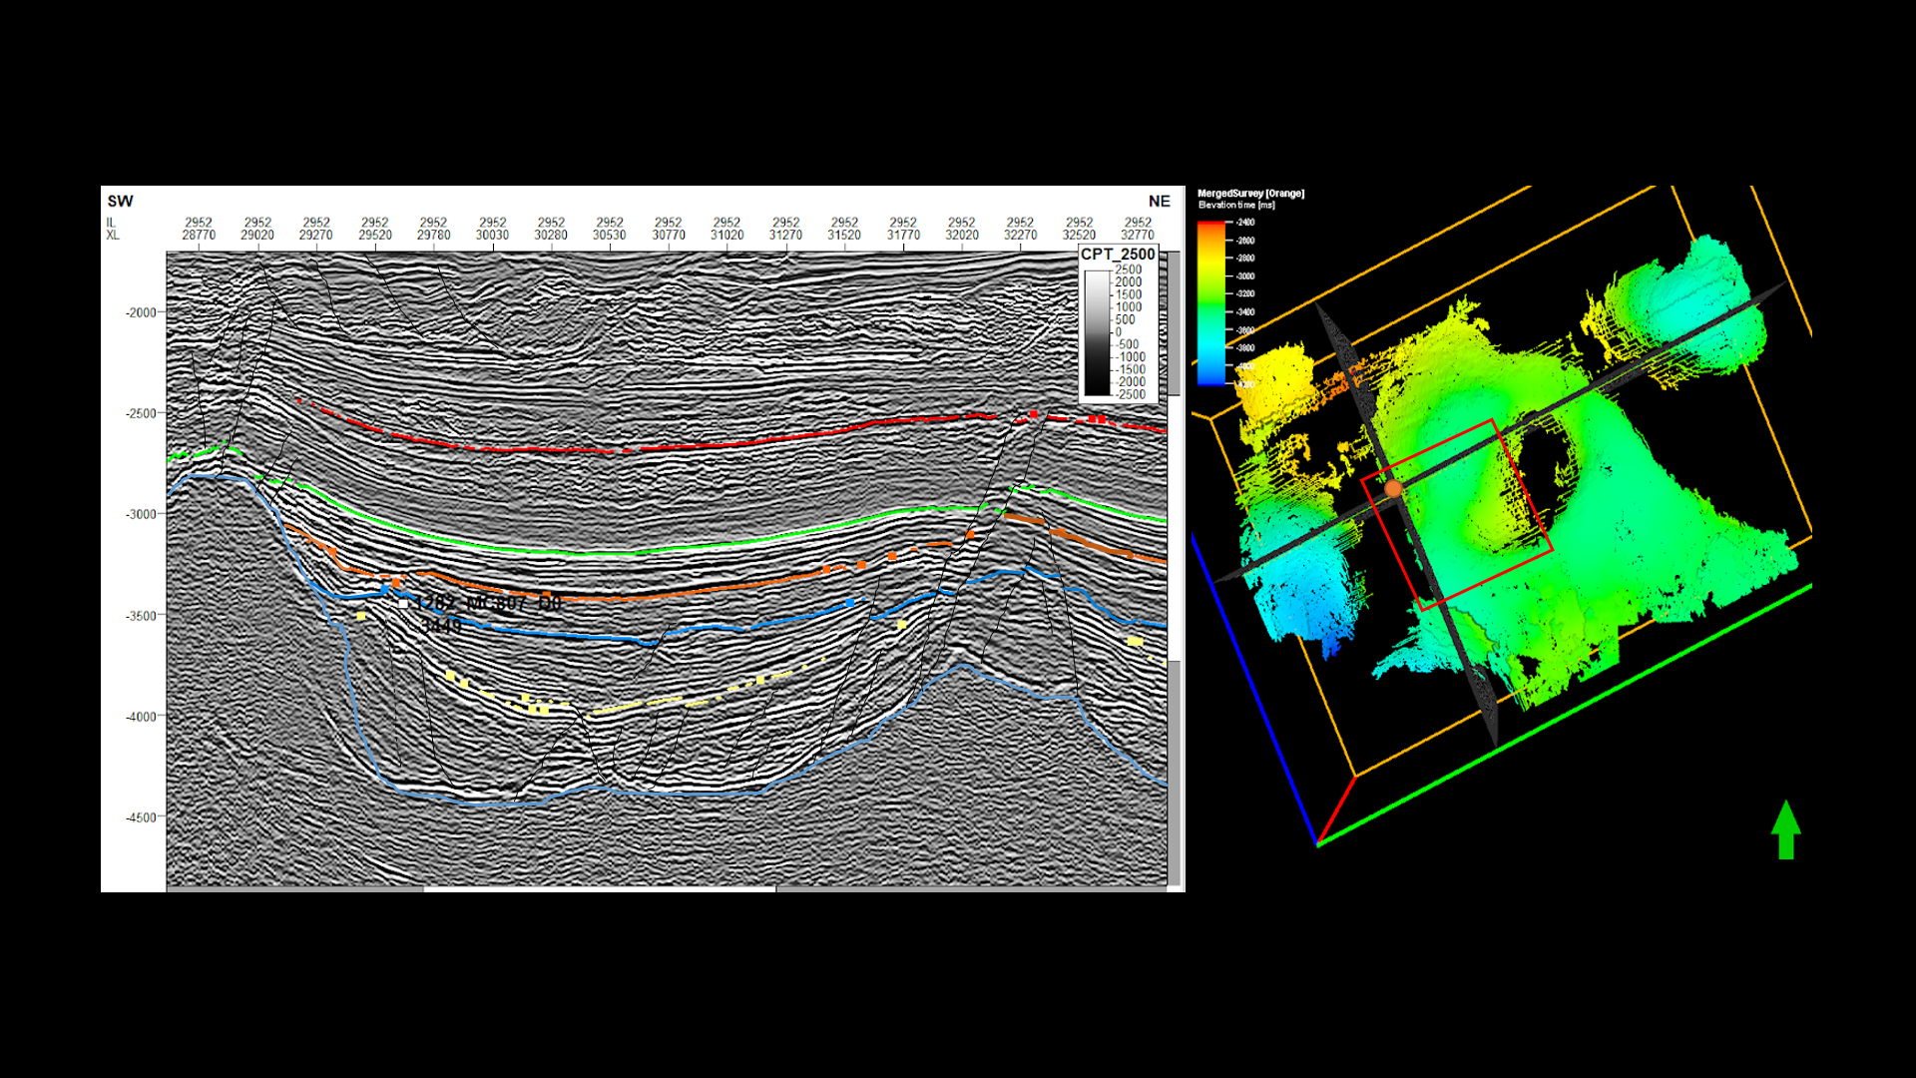
Proposed Drill Site
Inline 2952
Xlin 29280
Geological
Framework
Data
Analysis
Prospect
Elements
Prospect Assessment

Slide 27
Final Recommendation
Geological
Framework
Data
Analysis
Prospect
Elements
Prospect Assessment
Structural Interpretation
- Faults and folds
- Uplifts
- Structural trends/features
Stratigraphic Interpretation
- Unconformities
- Packages
- Facies, lithologies, ages
Present Day Conditions
Analyze Key Packages
- Potential Reservoirs
- Source Rocks
Identify Prospects
- Source
- Migration
- Reservoir
- Trap
Propose a Drill Site to Management
Chance of Success
- Trap size
- Hydrocarbon Content
- Compartments
- Recovery factor
Notes:
Develop geologic framework
Major faults, unconformities and stratigraphic packages (depositional sequences)
Structural interpretations
Faults folds
Uplifts
Structural trends and features
Stratigraphic interpretation
Unconformities
Packages
Facies, lithologies, ages
Basin reconstruction - how things evolved
Data analysis
Analyze all the key packages -- where are potential reservoirs, source rocks, etc
Present day conditions - how things are now
Prospect elements (Source, Migration, Reservoir, Trap)
Identify prospects -- where all the HC system elements look favorable
Where we are willing to propose a drill site to management
Prospect assessments
What type of volume of HC do we expect?
What is the chance of success or risk?

Slide 28
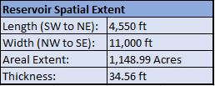
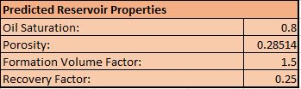
Reserve Estimates and Economic Analysis
Geological
Framework
Data
Analysis
Prospect
Elements
Prospect Assessment

Slide 29
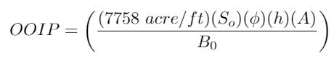
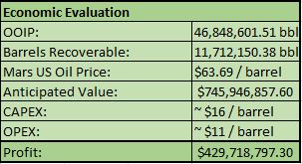
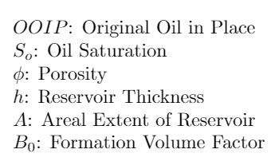
Reserve Estimates and Economic Analysis
Geological
Framework
Data
Analysis
Prospect
Elements
Prospect Assessment

Slide 30
Final Drill Site Recommendation
Inline 2952
Xlin 29280
Geological
Framework
Data
Analysis
Prospect
Elements
Prospect Assessment

Slide 31
Reference
[1] GPGN 558: Seismic Interpretation Lecture Notes
[2] Bouroullec, Renaud, et al. Petroleum Geology of TheMississippi Canyon,
AtwaterValley, Western DeSoto Canyon,and Western Lloyd Ridgeprotraction Areas, Northern Deep-Water Gulf of Mexico: Traps,Reservoirs, and Tectono-Stratigraphic Evolution.
[3] “Overview of Seismic Interpretation.” Robbie Gries: A Career of Many 'Firsts' -
AAPG Explorer April 2012,archives.aapg.org/slide_resources/schroeder/9/index.cfm.
[4] Diaz, Diego M. Economic Assessment of Deep-Water Fields in the Gulf of Mexico Under the
Licensing Scheme . University of Aberdeen,
www.abdn.ac.uk/research/acreef/documents/dissertation_posters_2016/MARTINEZ_DIAZ

